Slide 1

How Computer Science and Statistics Build Modern AI
Siyuan Wu
EAP II
Agnieszka Goeller
23 November 2025

Slide 2



Why I Chose This Topic: The Spark
The Origin Story
Back in 10th grade, I decided to build my own PC.
While picking a GPU, I fell down a rabbit hole learning about Nvidia DLSS.
DLSS
An AI-based upscaling technology by Nvidia that lets GPU render a game at a lower resolution and then uses a trained neural network to reconstruct a higher-resolution image.

Slide 3

DLSS basically double the frame per second

Slide 4

That experience sparked a genuine interest in Machine Learning, ultimately leads my interest to AI researching.
Double majoring Mathematics & Statistics and Computer Science

Slide 5
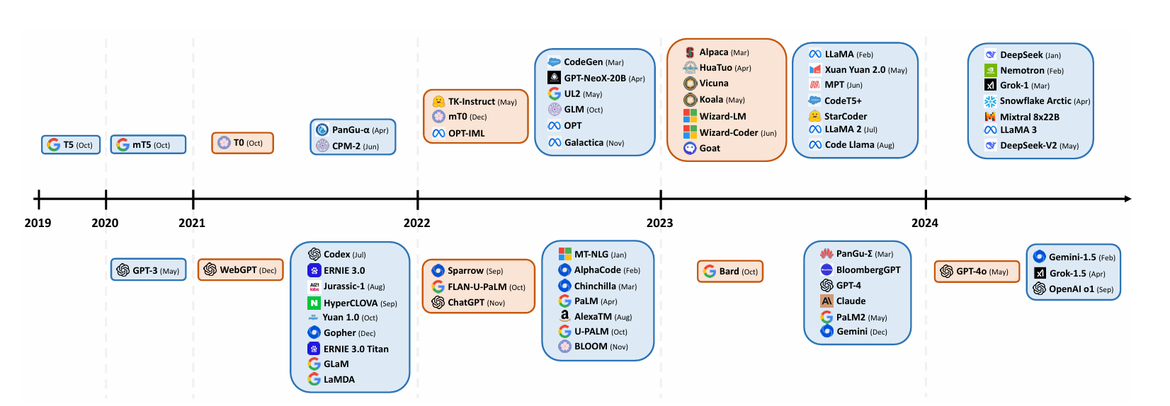
The Pivot
Started looking for DLSS, realized it was too specific. Zoomed out to general LLM development.
Databases
Rutgers University Libraries & arXiv (Cornell University).
Key Concepts
LLM, Token, Machine Learning / Reinforcement Learning, Scaling

Slide 6
Sources
Naveed, H., Khan, A. U., Qiu, S., Saqib, M., Anwar, S., Usman, M., Akhtar, N., Barnes, N., & Mian, A. (2025). A Comprehensive Overview of Large Language Models. The Association for Computing Machinery (ACM)
Ji, W., Yuan, W., Getzen, E., Cho, K., Jordan, M. I., Mei, S., Weston, J. E., Su, W. J., Xu, J., & Zhang, L. (2025). An Overview of Large Language Models for Statisticians.
arXiv
Min, J., Song, X., Zheng, S., King, C. B., Deng, X., & Hong, Y. (2024). Applied Statistics in the Era of Artificial Intelligence: A Review and Vision.
arXiv

Slide 7
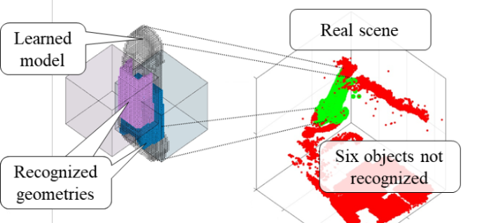

Overview of LLMs
An LLM is basically a gigantic text-prediction model. It’s trained on massive text datasets to guess the next small unit of text, called a token. If you string those predictions together, you get paragraphs, answers, and even full conversations. That’s the engine behind a lot of chatbots and AI writing tools we see now.

Slide 8
What I Learned
I thought AI was basically a Computer Science thing—just algorithms, coding, hardware.
From A Comprehensive Overview of Large Language Models I learned that statistics plays a major role in LLMs.
Adjusting LLM parameters (learning rate, batch size, token distribution) relies on statistical reasoning.
Model scaling laws (how performance changes with dataset size → parameters) are statistical-empirical.
My double major: CS covers the algorithmic/engineering side; Stats covers the inference, distribution, generalization side.

Slide 9

Evidence that LLMs are deeply statistical (Naveed et al., 2025)
Data preprocessing relies on metrics and statistics: 2.8. Data PreProcessing This section briefly summarizes data preprocessing techniques used in LLMs training. Quality Filtering: For better results, training data quality is essential. Some approaches to filtering data are: 1) classifier based and 2) heuristics-based. Classifier-based approaches train a classifier on high-quality data and predict the quality of text for filtering, whereas heuristics-based employ some rules for filtering like language, metrics, statistics, and keywords.
Scaling laws: tuning size & tokens via statistical patterns: Scaling laws study the optimal combination of model parameters, dataset size, and computational resources that predict the improvement in the model performance.
GPT 3: It shows that large models can train on larger batch sizes with a lower learning rate to decide the batch size during training, GPT-3 uses the gradient noise scale as in [107].

Slide 10
Source’s Credibility
A Comprehensive Overview of Large Language Models | ACM Transactions on Intelligent Systems and Technology
Author: Author: Humza Naveed, Asad Ullah Khan, Shi Qiu, Muhammad Saqib, Saeed Anwar, Muhammad Usman, Naveed Akhtar, Nick Barnes, Ajmal Mian
Humza Naveed: PhD in Computer Vision, University of Sydney
Qiu Shi: Research Assistant Professor at the Department of Computer Science and Engineering, the Chinese University of Hong Kong (CUHK)
They are all active researchers in ML/AI, affiliated with creditable universities.
Publication: ACM Transactions on Intelligent Systems and Technology, a journal published by Association for Computing Machinery (ACM). It targets audiences who are well educated and have some knowledge in AI field.
It’s a scholarly survey / review article in a computer-science journal. The authors explicitly describe it as “a comprehensive overview of the existing literature” and “this review article,” which is typical survey language.

Slide 11

What I Learned from the Project
Project 3 was the first time I really sat down and did a "deep dive" research session, spending an afternoon just reading complex academic papers.
In project 1 I talked about some diminishing local dialects, but with the invention and application of AI making a digital archive of those dialects become possible.
All the experiences I had while doing Project 3 can be further implement to Project 4

Slide 12
References
Naveed, Humza, et al. “A Comprehensive Overview of Large Language Models.” ACM Transactions on Intelligent Systems and Technology, 18 Aug 2025, https://dl.acm.org/doi/10.1145/3744746
Ji, Wenlong, et al. “An Overview of Large Language Models for Statisticians.” arXiv, 25 Feb. 2025, https://arxiv.org/abs/2502.17814
Min, Jie, et al. “Applied Statistics in the Era of Artificial Intelligence: A Review and Vision.” arXiv, 13 Dec. 2024, https://arxiv.org/abs/2412.10331

Slide 13
Questions?
How LLMs work?
What's the limit of AI?
Why you should invest in power companies on the stock market instead of the AI bubble?

